Slide 1




Slide 2


Abdelhak Razi
1CS Student
UX/UI Designer
Mobile Apps Developer

Slide 3

Popular Widgets
Buttons in Flutter
Slivers.
Adaptive & responsive widgets.

Slide 4

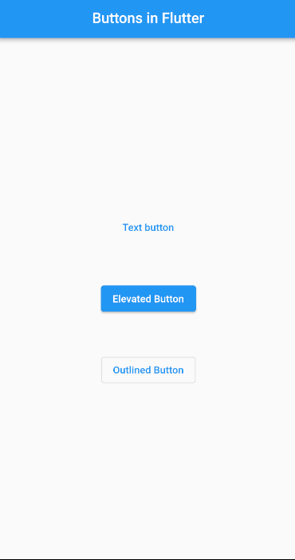
Buttons
in Flutter

Slide 5

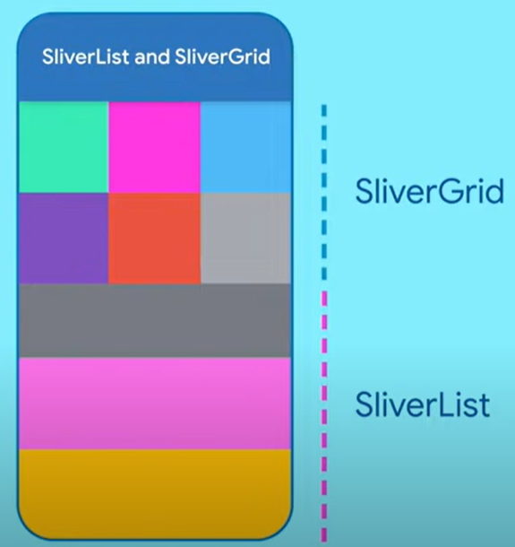
Slivers
in Flutter

Slide 6
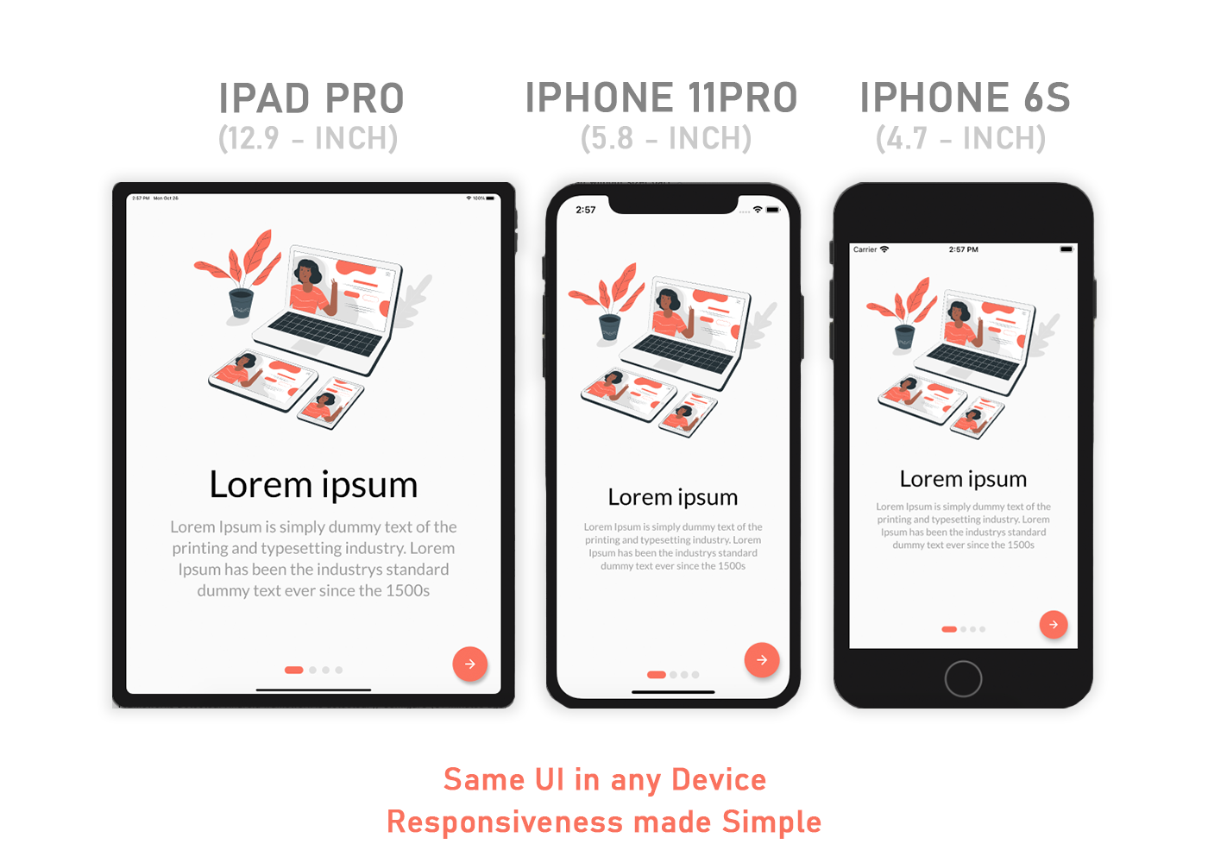
Responsive
Widgets

Slide 7
LayoutBuilder
OrientationBuilder
MediaQuery
FittedBox, Expanded, Flexible.
FractionallySizedBox

